Slide 1

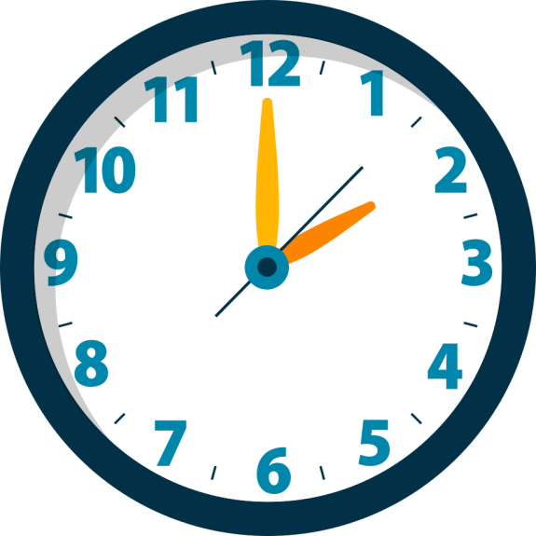



TIME
MANAGEMENT
COMPUTER SCIENCE 2

Slide 2


background
Students today are grappling with an overwhelming academic environment, often dealing with a lot of school tasks and competing deadlines. This complexity frequently results in missed work, which not only triggers significant stress but also directly leads to diminished academic performance.

Slide 3

problems
1
Students forget tasks due to reliance on memory and scattered notes.
2
Deadlines are missed because students fail to systematically monitor multiple assignments.
Workload lacks structure, making effective prioritization almost impossible.
Stress increases significantly when pending tasks quickly pile up and become overwhelming.
3
4

Slide 4



Importance of effective Time Management
Efficiency: Allows you to accomplish more in less time, freeing up space for leisure, rest, or other interests.
Clarity: Reduces the feeling of being overwhelmed by providing a structured plan for your day, minimizing forgetfulness and uncertainty.
Productivity: Ensures you are consistently working on the most valuable tasks (the right things) rather than just being busy (doing things quickly).
Focus: Helps you set boundaries, minimize distractions, and dedicate concentrated effort to high-priority items, improving the quality of your work.

Slide 5

objectives OF OUR PROGRAM
To develop a Python-based task management system that allows students to record tasks, mark them as completed, and calculate the total hours required to finish remaining work, thereby promoting better time management through a simple and intuitive interface
1.
2.
To transition from a command-line interface to a professional Graphical User Interface (GUI) that supports multi-user security and advanced task filtering.

Slide 6




features

Slide 7
Data-Driven Scheduling
Instant Workload Tally
Dynamic Status Update
Consolidated Task View
Allows students to input estimated hours and priority to inform planning decisions.
Automatically calculates and displays the total remaining hours for all pending assignments.
Provides a simple menu option to mark tasks as complete, instantly reflecting the workload change.
Displays all current tasks in one organized list, showing status, priority, and time required.
Multi-User Security Portal
Live Predictive Search
Bulk Management
PRO FEATURES:
Live Updates: I set up a "Search" feature that listens to your keyboard. As soon as you type a letter, the list updates instantly, no "Search" button required.
Automatic Priority: The app does the thinking for you when it comes to order. It uses a sorting rule that pushes your urgent "High Priority" tasks to the top and moves finished tasks to the bottom so they stay out of your way.
Safety First: To prevent the app from breaking, I added Input Validation. This means if you accidentally type "Two" instead of "2" for hours, the app will gently tell you there’s a mistake rather than just crashing.
Login system that gives privacy by allowing different users to manage their own task databases.
Real-time search "object" that filters the task list instantly as the user types, solving the problem of memory reliance.
Upgraded from marking tasks one-by-one to Multi-Select, allowing users to finish or delete groups of tasks together

Slide 8
Live updates
Automatic priority
Safety first
PRO FEATURES:
I set up a "Search" feature that listens to your keyboard. As soon as you type a letter, the list updates instantly, no "Search" button required.
The app does the thinking for you when it comes to order. It uses a sorting rule that pushes your urgent "High Priority" tasks to the top and moves finished tasks to the bottom so they stay out of your way.
To prevent the app from breaking, I added Input Validation. This means if you accidentally type "Two" instead of "2" for hours, the app will gently tell you there’s a mistake rather than just crashing.

Slide 9
User Experience (UX) Design
1.
Used Unicode Icons to create an intuitive workspace that reduces cognitive load.
2.
Implemented a darkthemed Control Sidebar and a light-themed Dashboard Workspace to separate "Input" from "Analysis," helping the student focus on high-priority items

Slide 10


inputs and outputs
Data Input and Task Inventory
1
The program first captures a comprehensive inventory of the student's workload. It requires the entry of critical task details: Name, Due Date, Estimated Hours, and Priority (High, Medium, or Low). This data is then stored and displayed in a single, organized list, providing a complete and reliable view of all academic responsibilities.
2
Status Monitoring and Time Quantification
The system actively tracks progress by displaying whether each task is Pending or Done. Students can easily mark tasks as completed, which instantly triggers the primary calculation: showing the total remaining hours for all unfinished tasks. This quantification helps students accurately estimate their time commitment and schedule work effectively.

Slide 11

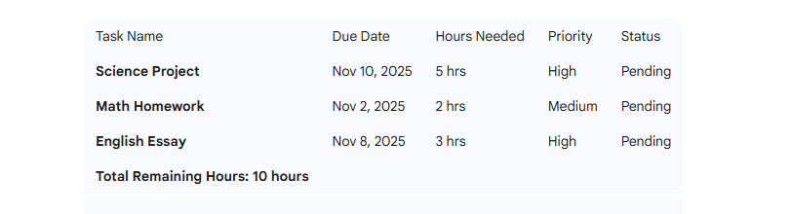
SAMPLE input
Input: Task Details Entered

Slide 12
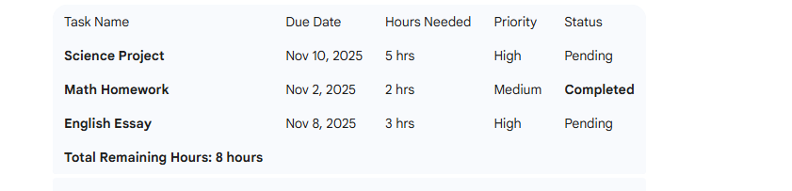
SAMPLE input
Output: Organized List

Slide 13
Process Flow (in Pseudocode)
CLASS LoginWindow:
INITIALIZE:
Load existing users from "users_db.json"
Create a hidden main window and a visible Login Popup
Setup UI: Account list (dropdown), Username entry, Password entry
FUNCTION check_login:
GET chosen user and typed password
IF user exists AND password matches:
Close Login Popup
Open Dashboard for that user
ELSE:
Show "Access Denied" error
FUNCTION register_user:
GET new username and password
IF fields are empty OR user already exists:
Show error message

Slide 14
Process Flow (in Pseudocode)
ELSE:
ADD user to database
SAVE to "users_db.json"
Show "Success" message
FUNCTION factory_reset:
IF user confirms:
DELETE the user database file
CLEAR the local user list

Slide 15
Process Flow (in Pseudocode)
CLASS TimeManagerGUI:
INITIALIZE:
LOAD user-specific tasks from "[username]_tasks.json"
SETUP SIDEBAR: Input fields for Task Name, Hours, and Priority
SETUP MAIN AREA: A table (Treeview) to display tasks and a Search bar
FUNCTION add_task:
GET name, hours, and priority from sidebar
VALIDATE that hours is a number
CREATE new task object (default status: Pending)
ADD to task list, SAVE to file, and REFRESH the table
FUNCTION update_list (The Display Engine):
CLEAR the current table display
GET search term from search bar
FILTER tasks based on the search term
SORT tasks (Pending tasks first, then by High -> Low priority)

Slide 16
Process Flow (in Pseudocode)
FOR each task:
IF completed: display "✅ COMPLETED"
ELSE: display "⌛ PENDING"
INSERT row into the table
FUNCTION mark_complete:
GET all selected rows from the table
FOR each selected row:
FIND matching task in the list and set "completed" to True
SAVE and REFRESH table
FUNCTION delete_task:
GET selected rows
IF user confirms:
REMOVE those tasks from the main list
SAVE and REFRESH table

Slide 17
Process Flow (in Pseudocode)
FUNCTION main:
CREATE the primary window (Tkinter root)
START LoginWindow
IF Login is successful:
LAUNCH TimeManagerGUI
KEEP the window open (Main Loop)
START Program

Slide 18
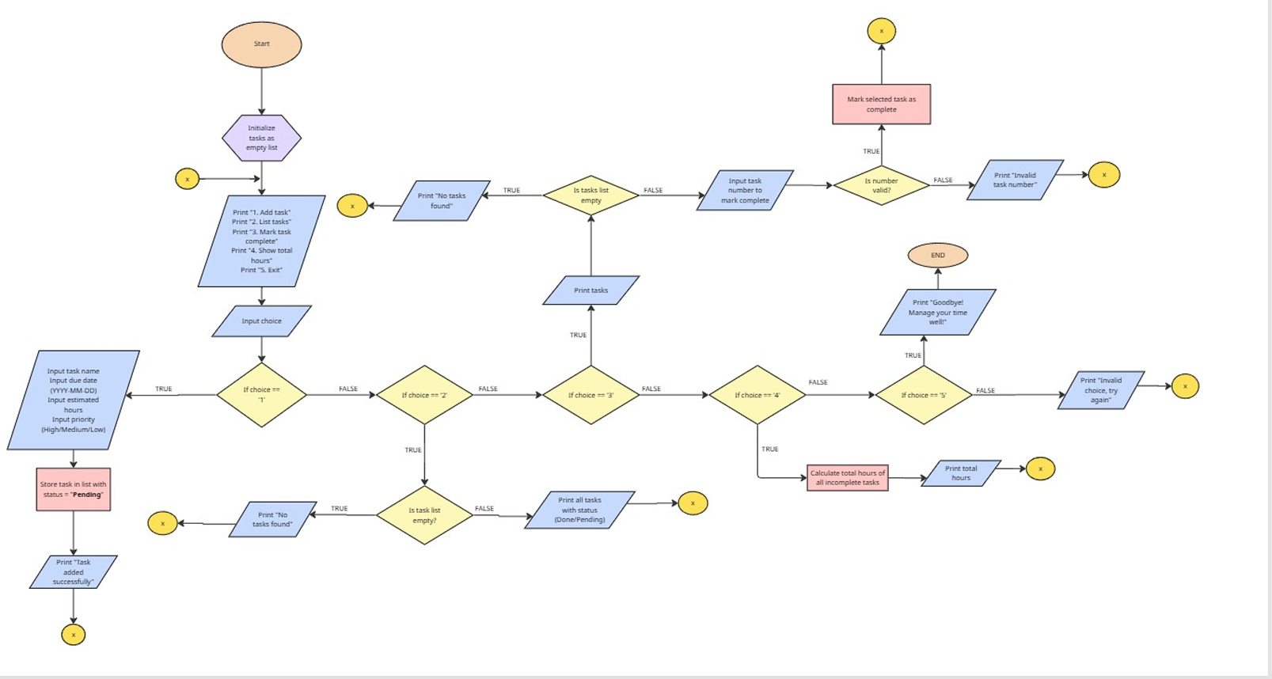

Slide 19
Methodology
Smart Organization: I used Object-Oriented Programming, which is just a fancy way of saying the code is split into two specialized parts, one that handles the front door (Login) and one that runs the actual office (the Dashboard).
Personalized Storage: Instead of dumping everyone’s data into one messy pile, the app creates a custom JSON file for every user. This keeps your "To-Do" list private and separate from anyone else using the system.
Clean Design: The layout uses a "Sidebar-Workspace" style. By putting the "Add Task" tools on the left and the "Big Picture" table on the right, it keeps the screen from feeling cluttered and makes it obvious what to do next.
Live Updates: I set up a "Search" feature that listens to your keyboard. As soon as you type a letter, the list updates instantly, no "Search" button required.
Automatic Priority: The app does the thinking for you when it comes to order. It uses a sorting rule that pushes your urgent "High Priority" tasks to the top and moves finished tasks to the bottom so they stay out of your way.
Safety First: To prevent the app from breaking, I added Input Validation. This means if you accidentally type "Two" instead of "2" for hours, the app will gently tell you there’s a mistake rather than just crashing.

Slide 20

CONCLUSION
Data Capture: The system efficiently captures all necessary details—Name, Due Date, Hours, and Priority—for each task.
Tracking and Status: It maintains a clear record of tasks, distinguishing between Pending and Completed status.
Time Awareness: By calculating the Total Remaining Hours, the program provides the student with a crucial metric for managing their overall workload and planning their study time effectively.
Professional Scalability: From a basic tracker to a scalable productivity tool, the system has shown that student-led software can leverage complex UI design to solve difficult time management problems like "workload piling up."

Slide 21
REFERENCE LIST ENTRY
Alshahrani, A., & Al-Samarraie, H. (2024). Mobile-based task management applications for students: A systematic literature review. Computers and Education: Artificial Intelligence, 6, 100207. https://doi.org/10.1016/j.caeai.2024.100207
Gore, R. (2019). Academic self-regulation and time management challenges among college students. Journal of Educational Psychology, 42(3), 112–125.
https://doi.org/10.1037/edu0000300
Macan, T. H., Shahani, C., Dipboye, R. L., & Phillips, A. P. (1990). College students' time management: Correlations with academic performance and stress. Journal of Educational Psychology, 82(4), 760–768.
https://doi.org/10.1037/0022-0663.82.4.760

Slide 22
THANK YOU FOR LISTENING
Therenz R. Ellema
Xanthus Matthew G. Vermug

